Slide 1
Micro Frontend
Notes:
https://martinfowler.com/articles/micro-frontends.html

Slide 2
The last mile of microservice
The Micro frontend architecture is a new paradigm that allows you to split the “frontend monolith” into small, reusable and independent user experiences.
These experiences have their own repositories, their own CI/CD pipeline and can be deployed and tested independently.
Notes:
Microservices advantages
decoupled codebase
autonomous teams
technology and framework agnostic
independent deployments
scalability
reusability

Slide 3
Benefits
Independent Deployments
Independent Teams
Decoupled Codebases
Developer Experience
Notes:
Independent Deployments
Reduced Risk: You are only deploying what has changed instead of the entire application. “If it is not broken don’t fix it”
Quick fixes to production: Avoiding dependencies on other teams or code allows you to ship critical fixes faster.
Simplified testing: Run tests for the individual frontends with defined boundaries and guarantee their functionality by following the single responsibility approach.
Independent Teams
Full ownership: Vertical slicing could be applied to the team structure to deliver features end to end, owning the entire tech stack.
Avoid dependencies: The team’s autonomy helps to reduce the need for coordination and helps avoid interference/blockers.
Faster time to market: Increased velocity and autonomy to push features out of the door faster.
Decoupled Codebases
Developer Experience: Improvements in productivity and focus.
Reduced Scope: Helps developers to understand the code better and prevents being overwhelmed by a huge codebase
Avoid accidental coupling: Developers only interact with specific parts of the code when developing new features and because there are set boundaries, this stops the need for connecting components that should not know about each other.
Reusability
Encapsulated Experiences: Features built as independent user experiences can be easily reused throughout the application.
Composition: similar to the reusability of components achieved by composition this approach can also be applied to micro frontends.
Reuse by other applications: Because micro frontends have their own CI/CD pipeline, they can be deployed to different applications and even be shared as “plug and play” solutions that contain all the business logic and UI presentation required to fulfil multiple use cases.

Slide 4
Approaches
iframe
DOM Render
Web Component
Notes:
iframe
retired
DOM Render
Vast majority of SPA micro frontend applications
Web Component
The future

Slide 5
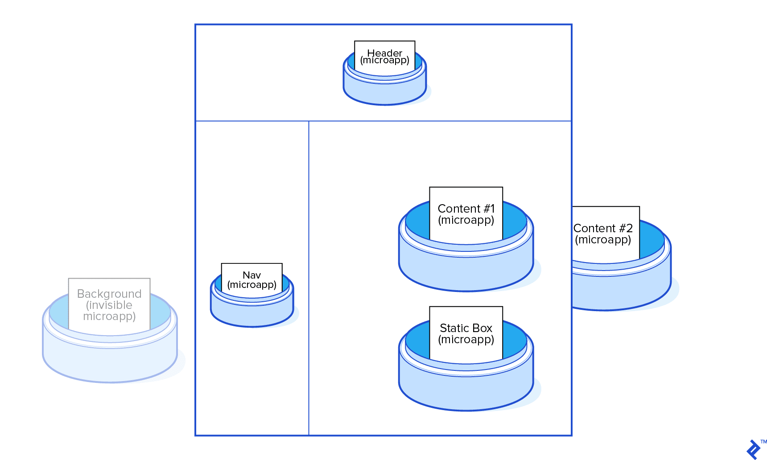

Slide 6

UI
UI
UI
UI
API
API
API
API
Storage
Storage
Storage
Storage

